Slide 1
CS 295A/395D: Artificial Intelligence
Decision Theory &
Game Theory
Prof. Emma Tosch
28 March 2022

Slide 2
Agenda
Wrapping up reasoning under uncertain state today
Introduce taking actions in the presence of uncertainty.
Elementary decision theory
Elementary game theory (making decisions given a game) concepts

Slide 3
Logistics
BB theory assignment out before next class
Update: bounties for real errors (will not be purposefully introducing errors)
Unlimited retries, soft deadline (recommended) before exam
Plan to wrap up this unit by Friday.
Next programming assignment out by the end of the week
Exam next week (Wednesday or Friday, to give you time to study)

Slide 4
Context: single decision
Two agents (“players”)
Take the perspective of a single player
Make one decision, under uncertainty
We will revisit game theory and search (e.g., minimax) after introducing reasoning over time

Slide 5
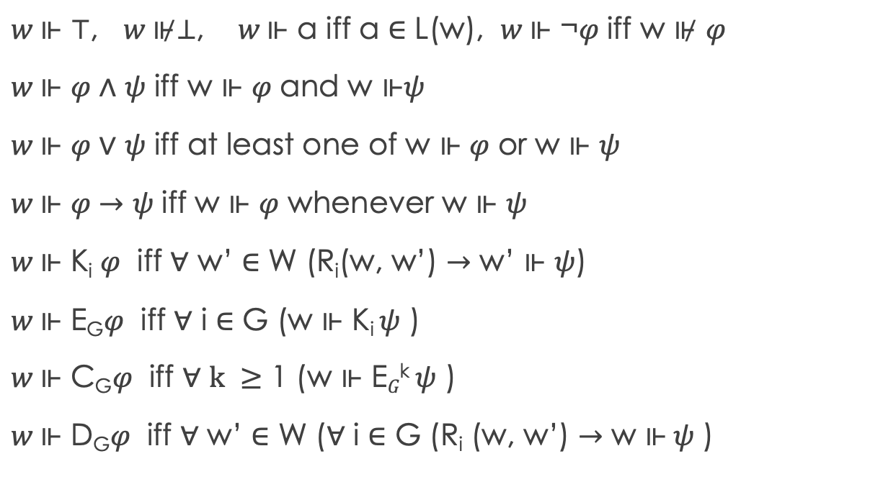

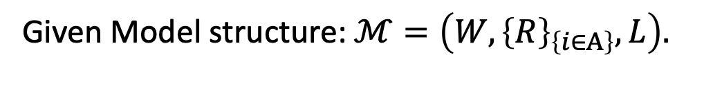
Recap: KT45^{n} syntax & Semantics
$$⊤ \left| ⊥ \right| p \left| ¬φ\right| φ_{1}∧φ_{2} \left| φ_{1}∨φ_{2} \right|{ φ}_{1}→φ_{2}$$
$$\left| {\text{K}}_{i}φ \right| E_{G}φ \left| C_{G}φ \right| D_{G}φ$$
Given Model structure: $ℳ=\left(W,{\left\{R\right\}}_{\left\{i∈A\right\}}, L\right).$
$w \text{⊩}$ ⊤, $w \text{⊮}$⊥, $w \text{⊩}$ a iff a ∈ L(w), $w \text{⊩}$ ¬𝜑 iff w ⊮ 𝜑
$w \text{⊩}$ 𝜑 ∧ 𝜓 iff w $\text{⊩}$ 𝜑 and w $\text{⊩}\text{ψ}$
$w \text{⊩}$ 𝜑 ∨ 𝜓 iff at least one of w $\text{⊩}$ 𝜑 or w $\text{⊩} \text{ψ}$
$w \text{⊩}$ 𝜑 $→$ 𝜓 iff w $\text{⊩}$ 𝜑 whenever w $\text{⊩ }\text{ψ}$
$w \text{⊩}$ K_{i} 𝜑 iff ∀ w’ ∈ W (R_{i}(w, w’) $→$ w’ $\text{⊩ }\text{ψ}$)
$w \text{⊩}$ E_{G}𝜑 iff ∀ i ∈ G (w $\text{⊩ }\text{Ki} \text{ψ}\text{ )}$
$w \text{⊩}$ C_{G}𝜑 iff ∀ $k ≥$ 1 (w $\text{⊩ }\text{E}G\text{k} \text{ψ}\text{ )}$
$w \text{⊩}$ D_{G}𝜑 iff ∀ w’ ∈ W (∀ i ∈ G (R_{i} (w, w’) $→$ w $\text{⊩} \text{ψ}\text{ )}$
w₂
p, q
R_{1,} R₂
w₁
R_{1,} R₂
q
p, q
w₃
R₁
w₄
p
q
R_{1,} R₂
w₆
w₅

Slide 6
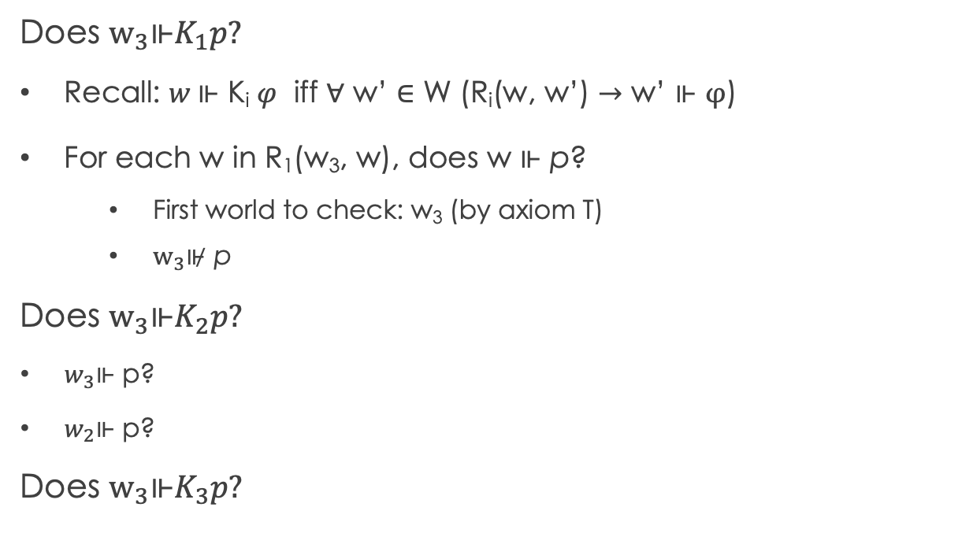
Recap: Evaluating formulas in KT45^{n}
Given Model structure: $ℳ=\left(W,{\left\{R\right\}}_{\left\{i∈A\right\}}, L\right).$
Does $w_{3}\text{⊩}K_{1}p?$
Recall: $w \text{⊩}$ K_{i} 𝜑 iff ∀ w’ ∈ W (R_{i}(w, w’) $→$ w’ $\text{⊩ }φ$)
For each w in R₁(w₃, w), does w $\text{⊩ }\text{p}$?
First world to check: w₃ (by axiom T)
$w_{3}\text{⊮} \text{p}$
Does $w_{3}\text{⊩}K_{2}p?$
$w_{3}\text{⊩}$ p?
$w_{2}\text{⊩}$ p?
Does $w_{3}\text{⊩}K_{3}p?$
w₂
p, q
R_{1,} R₂
w₁
R_{1,} R₂
q
p, q
w₃
R₁
w₄
p
q
R_{1,} R₂
w₆
w₅
Notes:
W2, w3

Slide 7
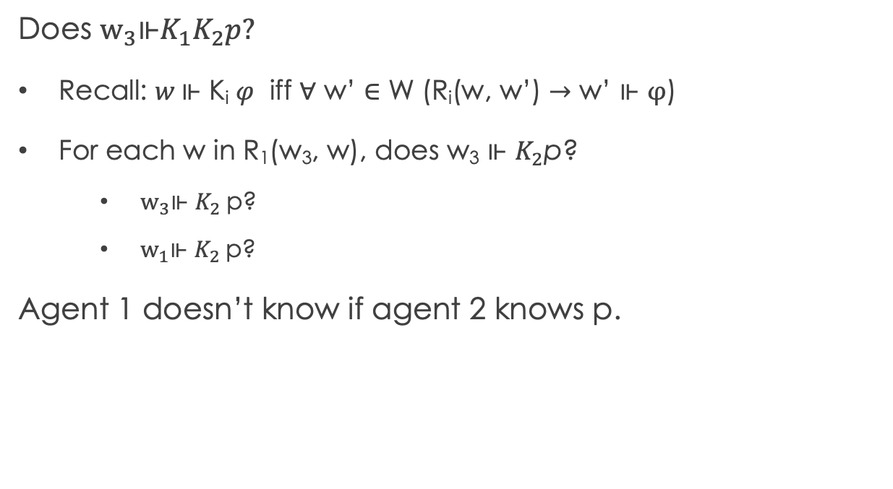
Recap: Evaluating formulas in KT45^{n}
Given Model structure: $ℳ=\left(W,{\left\{R\right\}}_{\left\{i∈A\right\}}, L\right).$
Does $w_{3}\text{⊩}K_{1}K_{2}p?$
Recall: $w \text{⊩}$ K_{i} 𝜑 iff ∀ w’ ∈ W (R_{i}(w, w’) $→$ w’ $\text{⊩ }φ$)
For each w in R₁(w₃, w), does w₃ $\text{⊩ }K_{2}\text{p}$?
$w_{3}\text{⊩} K_{2} \text{p}\text{?}$
$w_{1}\text{⊩} K_{2} \text{p}\text{?}$
Agent 1 doesn’t know if agent 2 knows p.
w₂
p, q
R_{1,} R₂
w₁
R_{1,} R₂
q
p, q
w₃
R₁
w₄
p
q
R_{1,} R₂
w₆
w₅
Notes:
W2, w3

Slide 8
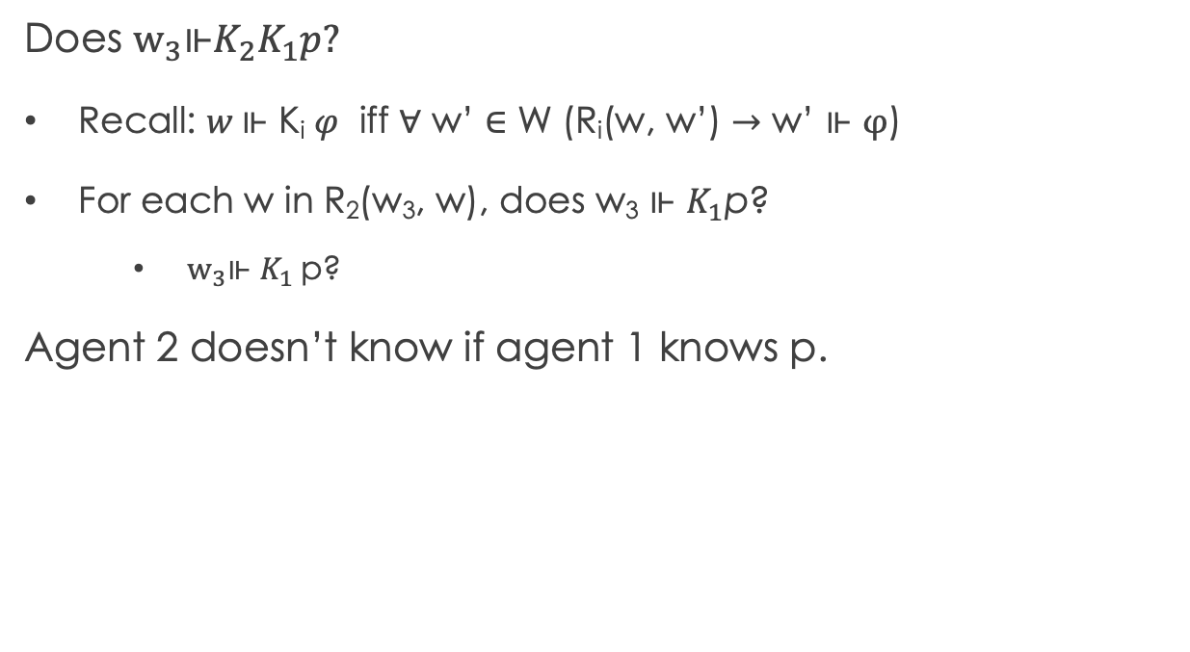
Recap: Evaluating formulas in KT45^{n}
Given Model structure: $ℳ=\left(W,{\left\{R\right\}}_{\left\{i∈A\right\}}, L\right).$
Does $w_{3}\text{⊩}K_{2}K_{1}p?$
Recall: $w \text{⊩}$ K_{i} 𝜑 iff ∀ w’ ∈ W (R_{i}(w, w’) $→$ w’ $\text{⊩ }φ$)
For each w in R₂(w₃, w), does w₃ $\text{⊩ }K_{1}\text{p}$?
$w_{3}\text{⊩} K_{1} \text{p}\text{?}$
Agent 2 doesn’t know if agent 1 knows p.
w₂
p, q
R_{1,} R₂
w₁
R_{1,} R₂
q
p, q
w₃
R₁
w₄
p
q
R_{1,} R₂
w₆
w₅
Notes:
W2, w3

Slide 9
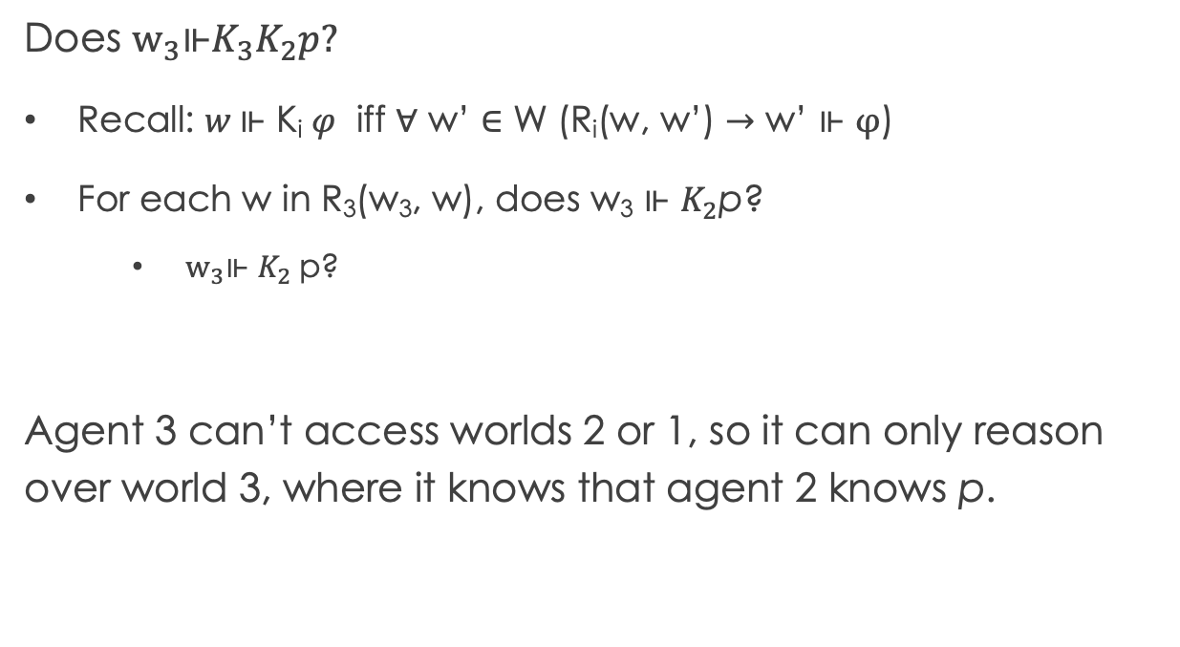
Recap: Evaluating formulas in KT45^{n}
Given Model structure: $ℳ=\left(W,{\left\{R\right\}}_{\left\{i∈A\right\}}, L\right).$
Does $w_{3}\text{⊩}K_{3}K_{2}p?$
Recall: $w \text{⊩}$ K_{i} 𝜑 iff ∀ w’ ∈ W (R_{i}(w, w’) $→$ w’ $\text{⊩ }φ$)
For each w in R₃(w₃, w), does w₃ $\text{⊩ }K_{2}\text{p}$?
$w_{3}\text{⊩} K_{2} \text{p}\text{?}$
Agent 3 can’t access worlds 2 or 1, so it can only reason over world 3, where it knows that agent 2 knows p.
w₂
p, q
R_{1,} R₂
w₁
R_{1,} R₂
q
p, q
w₃
R₁
w₄
p
q
R_{1,} R₂
w₆
w₅
Notes:
W2, w3

Slide 10
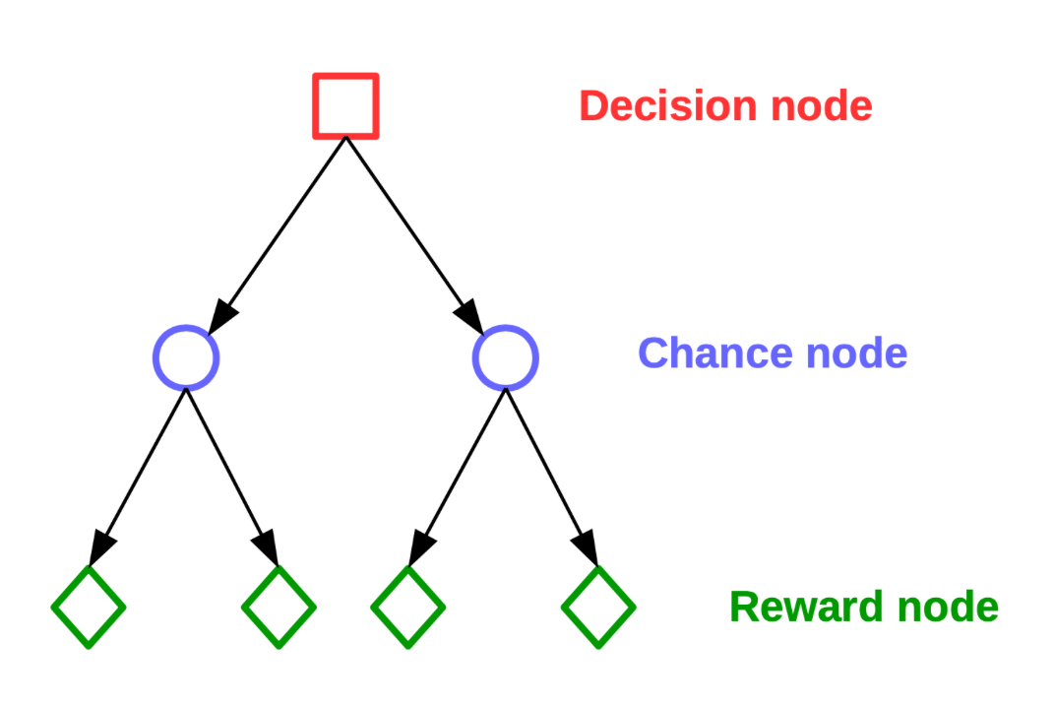
Basic Decision Theory
We can express taking actions in a world with uncertainty via decision trees
Decisions trees are temporally-ordered nodes where each level corresponds to alternating:
Decision nodes – state of the system; outgoing edges represent different actions
Chance nodes – probability distributions over outcomes; outgoing edges represent reachable states with some probability
Reward nodes – utility obtained from following the path
Note: “decision tree” also refers to a classification algorithm in machine learning and is completely different from the type of decision tree we will talk about here.

Slide 11
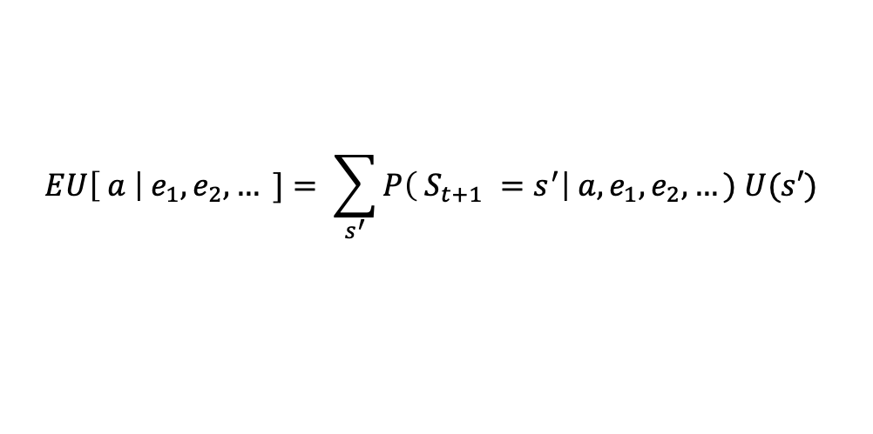
Goal: Maximize expected utility
$$EU\left[ a \right|{ e}_{1},e_{2},… ]= \sum_{s^{′}}{P\left( S_{t+1} =s^{′}\right| a, e_{1},e_{2},…) U(s′) }$$
Note: “decision tree” also refers to a classification algorithm in machine learning and is completely different from the type of decision tree we will talk about here.

Slide 12

Goal: Maximize expected utility
$$EU\left[ a \right|{ e}_{1},e_{2},… ]= \sum_{s^{′}}{P\left( S_{t+1} =s^{′}\right| a, e_{1},e_{2},…) U(s′) }$$
Best action is the action a that maximizes $EU\left[ a \right|{ e}_{1},e_{2},… ]$
Note: “decision tree” also refers to a classification algorithm in machine learning and is completely different from the type of decision tree we will talk about here.

Slide 13
Goal: Maximize expected utility
$$EU\left[ a \right|{ e}_{1},e_{2},… ]= \sum_{s^{′}}{P\left( S_{t+1} =s^{′}\right| a, e_{1},e_{2},…) U(s′) }$$
Best action is the action a that maximizes $EU\left[ a \right|{ e}_{1},e_{2},… ]$
Note: “decision tree” also refers to a classification algorithm in machine learning and is completely different from the type of decision tree we will talk about here.

Slide 14
Goal: Maximize expected utility
$$EU\left[ a \right|{ e}_{1},e_{2},… ]= \sum_{s^{′}}{P\left( S_{t+1} =s^{′}\right| a, e_{1},e_{2},…) U(s′) }$$
Best action is the action a that maximizes $EU\left[ a \right|{ e}_{1},e_{2},… ]$
Sum of the utility of actions taken.
Note: “decision tree” also refers to a classification algorithm in machine learning and is completely different from the type of decision tree we will talk about here.

Slide 15
Example: Buying a car
Problem setup:
Choice between 2 cars (C₁ and C₂), which can each be good (+) or bad (-) quality
Two tests that cost $$: (T₁ : $50, T₂: $20)
C₁ costs $500 below m.v., but if it’s bad quality, must be repaired for $700
C₂ costs $250 below m.v., but if it’s bad quality, must be repaired for $150
Must buy exactly one car and can perform at most one test before buying.

Slide 16
Example: Buying a car
P(C₁ = +) = 0.7
P(C₂ = +) = 0.8
Problem setup:
Choice between 2 cars (C₁ and C₂), which can each be good (+) or bad (-) quality
Two tests for each car that cost $$: (T₁ : $50, T₂: $20)
C₁ costs $500 below m.v., but if it’s bad quality, must be repaired for $700
C₂ costs $250 below m.v., but if it’s bad quality, must be repaired for $150
Must buy exactly one car and can perform at most one test before buying.

Slide 17
Example: Buying a car
P(C₁ = +) = 0.7
P(C₂ = +) = 0.8
P(T₁ = + | C₁ = +) = 0.8
P(T₁ = - | C₁ = -) = 0.65
P(T₂ = + | C₂ = +) = 0.75
P(T₂ = + | C₂ = +) = 0.7
Problem setup:
Choice between 2 cars (C₁ and C₂), which can each be good (+) or bad (-) quality
One test for each car that cost $$: (T₁ : $50, T₂: $20)
C₁ costs $500 below m.v., but if it’s bad quality, must be repaired for $700
C₂ costs $250 below m.v., but if it’s bad quality, must be repaired for $150
Must buy exactly one car and can perform at most one test before buying.
What are the expected costs of C₁ and C₂ assuming you run no tests? (Board 1)

Slide 18
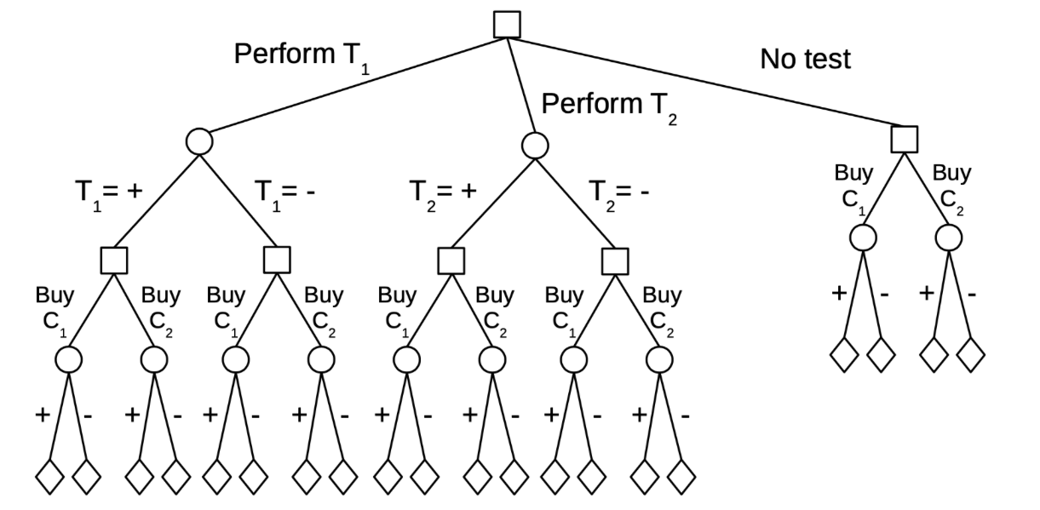

Slide 19
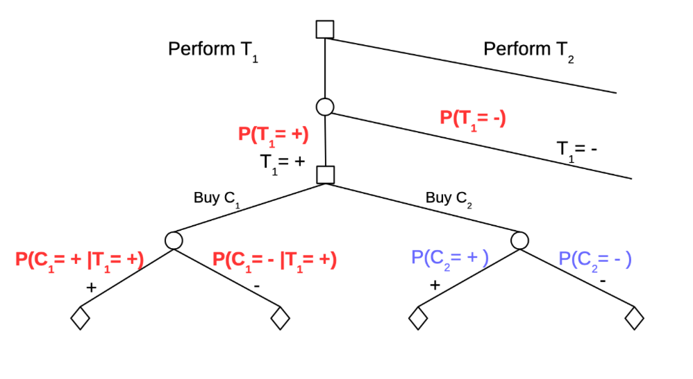
What is the expected cost of buying C₁ and C₂ assuming you run T₁ on C₁?
Set up decision between T₁ and T₂ (Board 2)

Slide 20
When uncertainty comes from another agent’s actions
Car example: taking an action in one branch closes off possibilities in another
Uncertainty comes from the resulting state
Knowledge released due to release of information
No mutation! → these are all possible worlds where you are the only agent
How to reason when there are other agents’ actions?
Game theory!

Slide 21
Example: Prisoner’s Dilemma
Collective cost?
You and an accomplice have been arrested for a crime and separated for interrogation. You have the choice of whether or not to confess and each action is associated with a cost. You don’t know how your accomplice will act. What do you do?
Q silent
P silent
P talks
(0, 0) | (-2, -5)
(-5, -2) | (-10, -10)
Q talks
Both parties know this matrix

Slide 22
Example: Prisoner’s Dilemma
Collective cost?
You and an accomplice have been arrested for a crime and separated for interrogation. You have the choice of whether or not to confess and each action is associated with a cost. You don’t know how your accomplice will act. What do you do?
Q silent
P silent
P talks
0 | -7
-7 | -20
Q talks
Both parties know this matrix

Slide 23
Example: Prisoner’s Dilemma
Individual Cost?
You and an accomplice have been arrested for a crime and separated for interrogation. You have the choice of whether or not to confess and each action is associated with a cost. You don’t know how your accomplice will act. What do you do?
Q silent
P silent
P talks
(0, 0) | (-2, -5)
(-5, -2) | (-10, -10)
Q talks
Both parties know this matrix

Slide 24
Example: Prisoner’s Dilemma
Individual cost?
You and an accomplice have been arrested for a crime and separated for interrogation. You have the choice of whether or not to confess and each action is associated with a cost. You don’t know how your accomplice will act. What do you do?
Q silent
P silent
P talks
0 | -2
-5 | -10
Q talks
Both parties know this matrix

Slide 25
Example: Prisoner’s Dilemma
Individual cost?
You and an accomplice have been arrested for a crime and separated for interrogation. You have the choice of whether or not to confess and each action is associated with a cost. You don’t know how your accomplice will act. What do you do?
Q silent
P silent
P talks
0 | -5
-2 | -10
Q talks
Both parties know this matrix

Slide 26
Example: Prisoner’s Dilemma
You and an accomplice have been arrested for a crime and separated for interrogation. You have the choice of whether or not to confess and each action is associated with a cost. You don’t know how your accomplice will act. What do you do?
Q silent
P silent
P talks
Decision/action
(0, 0) | (-2, -5)
(-5, -2) | (-10, -10)
Q talks
Uncertainty

Slide 27
Example: Prisoner’s Dilemma
You and an accomplice have been arrested for a crime and separated for interrogation. You have the choice of whether or not to confess and each action is associated with a cost. You don’t know how your accomplice will act. What do you do?
Q silent
P silent
P talks
Uncertainty
(0, 0) | (-2, -5)
(-5, -2) | (-10, -10)
Q talks
Decision/action

Slide 28
Example: Prisoner’s Dilemma
You and an accomplice have been arrested for a crime and separated for interrogation. You have the choice of whether or not to confess and each action is associated with a cost. You don’t know how your accomplice will act. What do you do?
Q silent
P silent
P talks
(0, 0) | (-2, -5)
(-5, -2) | (-10, -10)
Q talks

Slide 29
Example: Prisoner’s Dilemma
You and an accomplice have been arrested for a crime and separated for interrogation. You have the choice of whether or not to confess and each action is associated with a cost. You don’t know how your accomplice will act. What do you do?
Q silent
P silent
P talks
(0, 0) | (-2, -5)
(-5, -2) | (-10, -10)
Q talks

Slide 30
Example: Prisoner’s Dilemma
You and an accomplice have been arrested for a crime and separated for interrogation. You have the choice of whether or not to confess and each action is associated with a cost. You don’t know how your accomplice will act. What do you do?
Q silent
P silent
P talks
(0, 0) | (-2, -5)
(-5, -2) | (-10, -10)
Q talks

Slide 31
Example: Prisoner’s Dilemma
You and an accomplice have been arrested for a crime and separated for interrogation. You have the choice of whether or not to confess and each action is associated with a cost. You don’t know how your accomplice will act. What do you do?
Q silent
P silent
P talks
(0, 0) | (-2, -5)
(-5, -2) | (-10, -10)
Q talks

Slide 32
Example: Prisoner’s Dilemma
You and an accomplice have been arrested for a crime and separated for interrogation. You have the choice of whether or not to confess and each action is associated with a cost. You don’t know how your accomplice will act. What do you do?
Q silent
P silent
P talks
(0, 0) | (-2, -5)
(-5, -2) | (-10, -10)
Q talks

Slide 33
Example: Prisoner’s Dilemma
You and an accomplice have been arrested for a crime and separated for interrogation. You have the choice of whether or not to confess and each action is associated with a cost. You don’t know how your accomplice will act. What do you do?
Q silent
P silent
P talks
(0, 0) | (-2, -5)
(-5, -2) | (-10, -10)
Q talks

Slide 34
Example: Prisoner’s Dilemma
You and an accomplice have been arrested for a crime and separated for interrogation. You have the choice of whether or not to confess and each action is associated with a cost. You don’t know how your accomplice will act. What do you do?
Q silent
P silent
P talks
(0, 0) | (-2, -5)
(-5, -2) | (-10, -10)
Q talks
Same as globally optimal case

Slide 35
Example: Prisoner’s Dilemma
You and an accomplice have been arrested for a crime and separated for interrogation. You have the choice of whether or not to confess and each action is associated with a cost. You don’t know how your accomplice will act. What do you do?
Q silent
P silent
P talks
(0, 0) | (-2, -5)
(-5, -2) | (-10, -10)
Q talks
Same as globally optimal case

Slide 36
Example: Prisoner’s Dilemma
You and an accomplice have been arrested for a crime and separated for interrogation. You have the choice of whether or not to confess and each action is associated with a cost. You don’t know how your accomplice will act. What do you do?
Q silent
P silent
P talks
(0, 0) | (-2, -5)
(-5, -2) | (-10, -10)
Q talks

Slide 37
Example: Prisoner’s Dilemma
You and an accomplice have been arrested for a crime and separated for interrogation. You have the choice of whether or not to confess and each action is associated with a cost. You don’t know how your accomplice will act. What do you do?
Q silent
P silent
P talks
(-2, -2) | (0, -15)
(-15, 0) | (-10, -10)
Q talks
Still collectively optimal?

Slide 38
Example: Prisoner’s Dilemma
You and an accomplice have been arrested for a crime and separated for interrogation. You have the choice of whether or not to confess and each action is associated with a cost. You don’t know how your accomplice will act. What do you do?
Q silent
P silent
P talks
-4 | -15
-15 | -20
Q talks
Still collectively optimal?

Slide 39
Example: Prisoner’s Dilemma
You and an accomplice have been arrested for a crime and separated for interrogation. You have the choice of whether or not to confess and each action is associated with a cost. You don’t know how your accomplice will act. What do you do?
Q silent
P silent
P talks
-2 | 0
-15 | -10
Q talks
Still individually optimal?

Slide 40
Example: Prisoner’s Dilemma
Choice depends on other agent’s actions
You and an accomplice have been arrested for a crime and separated for interrogation. You have the choice of whether or not to confess and each action is associated with a cost. You don’t know how your accomplice will act. What do you do?
Q silent
P silent
P talks
-2 | -15
0 | -10
Q talks
Still individually optimal?

Slide 41
Example: Prisoner’s Dilemma
You and an accomplice have been arrested for a crime and separated for interrogation. You have the choice of whether or not to confess and each action is associated with a cost. You don’t know how your accomplice will act. What do you do?
Q silent
P silent
P talks
(-2, -2) | (0, -15)
(-15, 0) | (-10, -10)
Q talks
Do on board

Slide 42
Example: Prisoner’s Dilemma
You and an accomplice have been arrested for a crime and separated for interrogation. You have the choice of whether or not to confess and each action is associated with a cost. You don’t know how your accomplice will act. What do you do?
Q silent
P silent
P talks
(-2, -2) | (0, -15)
(-15, 0) | (-10, -10)
Q talks

Slide 43
Example: Prisoner’s Dilemma
You and an accomplice have been arrested for a crime and separated for interrogation. You have the choice of whether or not to confess and each action is associated with a cost. You don’t know how your accomplice will act. What do you do?
Q silent
P silent
P talks
(-2, -2) | (0, -15)
(-15, 0) | (-10, -10)
Q talks

Slide 44
Example: Prisoner’s Dilemma
You and an accomplice have been arrested for a crime and separated for interrogation. You have the choice of whether or not to confess and each action is associated with a cost. You don’t know how your accomplice will act. What do you do?
Q silent
P silent
P talks
(-2, -2) | (0, -15)
(-15, 0) | (-10, -10)
Q talks

Slide 45
Example: Prisoner’s Dilemma
You and an accomplice have been arrested for a crime and separated for interrogation. You have the choice of whether or not to confess and each action is associated with a cost. You don’t know how your accomplice will act. What do you do?
Q silent
P silent
P talks
(-2, -2) | (0, -15)
(-15, 0) | (-10, -10)
Q talks

Slide 46
Example: Prisoner’s Dilemma
You and an accomplice have been arrested for a crime and separated for interrogation. You have the choice of whether or not to confess and each action is associated with a cost. You don’t know how your accomplice will act. What do you do?
Q silent
P silent
P talks
(-2, -2) | (0, -5)
(-5, 0) | (-10, -10)
Q talks

Slide 47
Example: Prisoner’s Dilemma
You and an accomplice have been arrested for a crime and separated for interrogation. You have the choice of whether or not to confess and each action is associated with a cost. You don’t know how your accomplice will act. What do you do?
Q silent
P silent
P talks
(-2, -2) | (0, -5)
(-5, 0) | (-10, -10)
Q talks

Slide 48
Example: Prisoner’s Dilemma
You and an accomplice have been arrested for a crime and separated for interrogation. You have the choice of whether or not to confess and each action is associated with a cost. You don’t know how your accomplice will act. What do you do?
Q silent
P silent
P talks
(-2, -2) | (0, -5)
(-5, 0) | (-10, -10)
Q talks

Slide 49
Example: Prisoner’s Dilemma
You and an accomplice have been arrested for a crime and separated for interrogation. You have the choice of whether or not to confess and each action is associated with a cost. You don’t know how your accomplice will act. What do you do?
Q silent
P silent
P talks
(-2, -2) | (0, -5)
(-5, 0) | (-10, -10)
Q talks

Slide 50
Example: Prisoner’s Dilemma
You and an accomplice have been arrested for a crime and separated for interrogation. You have the choice of whether or not to confess and each action is associated with a cost. You don’t know how your accomplice will act. What do you do?
Q silent
P silent
P talks
(-2, -2) | (0, -5)
(-5, 0) | (-10, -10)
Q talks

Slide 51
Example: Prisoner’s Dilemma
You and an accomplice have been arrested for a crime and separated for interrogation. You have the choice of whether or not to confess and each action is associated with a cost. You don’t know how your accomplice will act. What do you do?
Q silent
P silent
P talks
(-2, -2) | (0, -5)
(-5, 0) | (-10, -10)
Q talks

